Slide 1
Hierarchical Subquery Evaluation for Active Learning on a Graph
CVPR 2014
Oisin Mac Aodha, Neill Campbell, Jan Kautz, Gabriel Brostow
University College London

Slide 2

Large Image Collections
Cat
Dog
Horse
https://www.flickr.com/photos/cmichel67
Notes:
Acquiring large unlabeled image datasets has never been easier.
Imagenet Large Scale Visual Recognition Classification Challenge contains 1.2 million images and 1000 classes

Slide 3
Large Image Collections
Cat
Dog
Horse
https://www.flickr.com/photos/cmichel67
Labeling large image collections is tedious
Notes:
However annotating those datasets can be very tedious.
Specific example

Slide 4



Acquiring Annotations
Crowdsourcing
Specialized Knowledge
https://www.flickr.com/photos/usnavy
https://www.flickr.com/photos/rdecom
Expert time is valuable!
Notes:
Crowd sourcing does not work when domain specific knowledge is required.
Expert time is valuable – we want to minimize the amount of their time we have to waste.

Slide 5
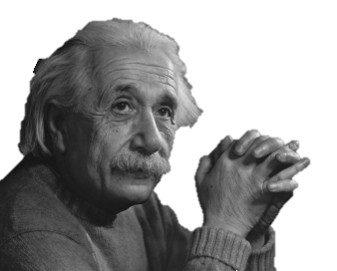
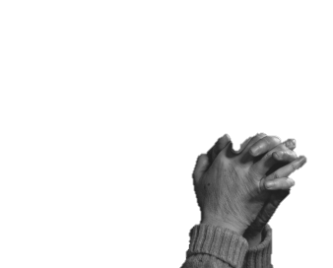
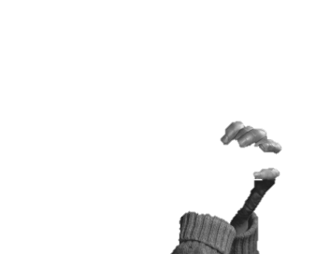
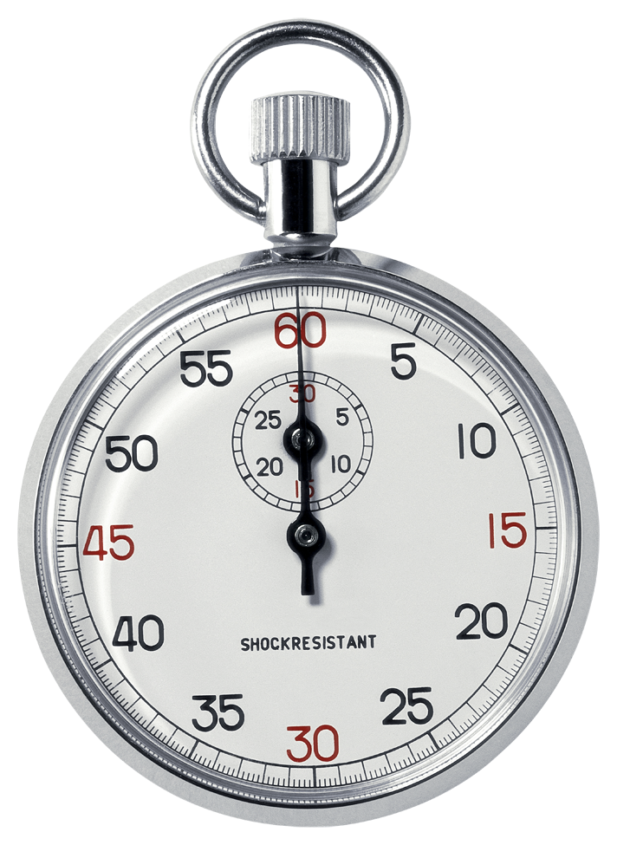

Active Learning
User Query
Oracle
Label
Unlabeled
Dataset
AL Algorithm
Notes:
User query. Sub query

Slide 6
Learning Curves
1
Test
Accuracy
0
Number of user queries
Notes:
Given an already labeled dataset one way to evaluate how good a particular strategy is is to display the leanring curve.

Slide 7
Learning Curves
1
Test
Accuracy
0
Number of user queries

Slide 8
Learning Curves
1
Test
Accuracy
0
Number of user queries

Slide 9
Learning Curves
1
Test
Accuracy
0
Number of user queries

Slide 10
Learning Curves
1
Test
Accuracy
0
Number of user queries

Slide 11
Learning Curves
1
We want the largest area under the learning curve
Test
Accuracy
0
Number of user queries
Notes:
Active learning can help us reduce the user time. Ask the right questions in the right order.

Slide 12
Learning Curves
1
The number of unlabeled images can be very large!
Test
Accuracy
0
Notes:
Will run out of money before you run out of data

Slide 13
Active Learning Wish List

Slide 14
Active Learning Wish List
Fast updating of classifier for interactive labeling

Slide 15
Active Learning Wish List
Fast updating of classifier for interactive labeling
Exploit structure in unlabeled data

Slide 16
Active Learning Wish List
Fast updating of classifier for interactive labeling
Exploit structure in unlabeled data
Consistent performance across different datasets

Slide 17
Active Learning Wish List
Graph Based
Semi-Supervised
Learning
Perplexity Graph
Construction
Our Hierarchical
Subquery Evaluation
Fast updating of classifier for interactive labeling
Exploit structure in unlabeled data
Consistent performance across different datasets
Make the most of the expert’s time
Notes:
In this talk I will present our proposed solution to these problems.

Slide 18
Related Work
Image Classification
Kapoor et al. ICCV 2007
Gaussian Random Fields
Zhu et al. ICML 2003
Video Segmentation
Fathi et al. BMVC 2011
RALF: Reinforced Active Learning
Ebert et al. CVPR 2012
Semantic Segmentation
Vezhnevets et al. CVPR 2012
…
Action Detection
Bandla and Grauman ICCV 2013
…
Notes:
There has been a large amount of work in active learning for vision.
This is the family of AL algorithms that we are based in.

Slide 19
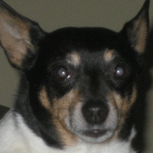
Supervised Classification
φ(
) =
x_{i}
Notes:
For standard image classification we …

Slide 20
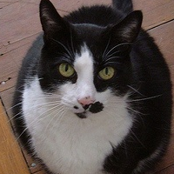
Supervised Classification
φ(
) =
x_{j}

Slide 21
Supervised Classification

Slide 22
Supervised Classification
Decision Boundary
Notes:
w is high if things are similar

Slide 23
Semi-Supervised Learning
F_{i} = P(f(x_{i}) == class1)
w_{ij}
Semi-supervised learning using Gaussian ﬁelds and harmonic functions
X. Zhu, Z. Ghahramani, J. Lafferty
ICML 2003
Notes:
w is high if things are similar

Slide 24
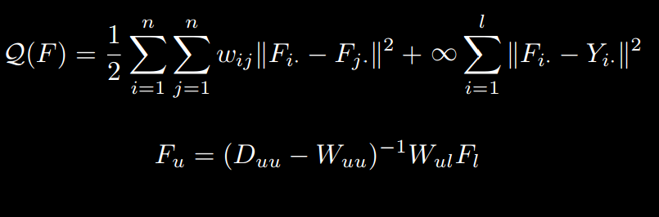
Semi-Supervised Learning
F_{i} = P(f(x_{i}) == class1)
w_{ij}
Notes:
Energy that we want to minimize
Here for the binary case
Nearby by nodes to be similar class and enforce that labeled nodes have the value given by user.

Slide 25
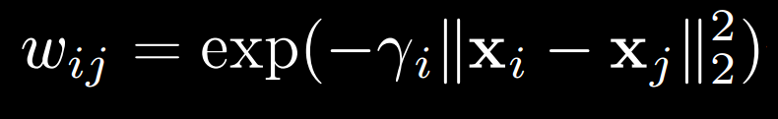
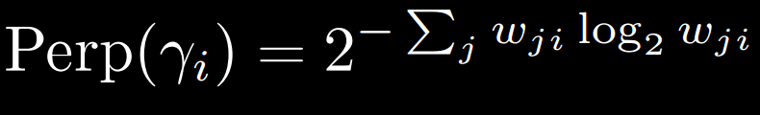
Graph Construction
Stochastic neighbor embedding
G. Hinton and S. Roweis
NIPS 2002
Notes:
An open question is how to best construct the graph. Naïve way is to choose the same RBF parameters for the entire dataset.
Want gamma to be high in dense regions of the feature space and lower in more sparse areas.
We perform a binary search to find the value of gamma that will best match a given level of perplexity. A measure of the effective number of nearest neighbors.
See our paper for more details.

Slide 26
Graph Active Learning

Slide 27
Example 2 Class Graph
Notes:
But unlabeled it looks like this. We now need a strategy for choosing the best user query.

Slide 28
Example 2 Class Graph
Ground Truth
Notes:
** Now we have a graph.
The following is a binary classification problem in 2D. We have a connected graph.

Slide 29
Active Learning Strategies
Example 2 Class Graph
Notes:
But unlabeled it looks like this. We now need a strategy for choosing the best user query.

Slide 30
Active Learning Strategies
• Random
Notes:
Now that we have our classifer we next need a active learning strategy to help us choose unlabeled examples.
Puts refs here

Slide 31
Active Learning Strategies
• Random
Exploration – clusters

Slide 32
Active Learning Strategies
• Random
Exploration – clusters
Exploitation – uncertainty

Slide 33
Active Learning Strategies
• Random
Exploration – clusters
Exploitation – uncertainty

Slide 34
Active Learning Strategies
• Random
Exploration – clusters
Exploitation – uncertainty
RALF – explore or exploit
Ralf: A reinforced active learning formulation for object class recognition
S. Ebert, M. Fritz, and B. Schiele
CVPR 2012

Slide 35
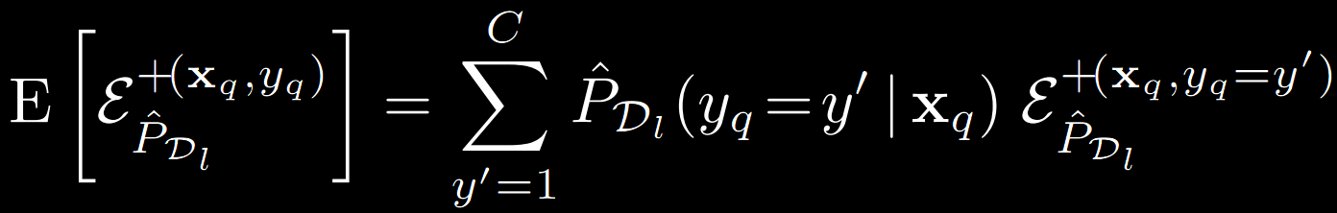
Active Learning Strategies
• Random
Exploration – clusters
Exploitation – uncertainty
RALF – explore or exploit
Expected Error Reduction – reduce future error
Toward optimal active learning through sampling estimation of error reduction
N. Roy and A. McCallum
ICML 2001
Notes:
+ is the learner with datapoint added to the labeled data.
We use the learners current posterior P_DL_hat to approximate the unknown true distribution of yq – this allows us to compute the expected error/risk which we then minimize.
Not choosing the example with the lowest entropy like uncertainty but the one which is most expected to reduce entropy among all the unlabeled data

Slide 36
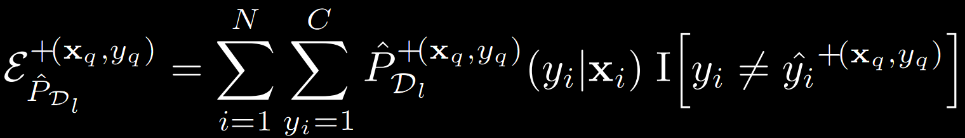
Expected Error Reduction
Notes:
We use the learners current posterior P_DL_hat to approximate the unknown true distribution of yq.

Slide 37
Expected Error Reduction
Ground Truth
2 Labeled Points
Notes:
Using GFHF to propagate the label information around the graph

Slide 38
Expected Error Reduction
Ground Truth
Current Class
Distribution
Notes:
Here we display the class with the highest probability at each node. Maximum likelihood class.
We want to label the example that will separate the distribution across all unlabeled examples the most

Slide 39
Expected Error Reduction
Ground Truth
Compute the Expected Error (EE) for each unlabled datapoint
Notes:
Lets use the structure in the data

Slide 40
Expected Error Reduction
Ground Truth
?
Hypothesize label 1
Class 1 Class 2
Notes:
Lets use the structure in the data

Slide 41
Expected Error Reduction
Ground Truth
?
Update model
Notes:
Lets use the structure in the data

Slide 42
Expected Error Reduction
Ground Truth
?
Hypothesize label 2
Class 1 Class 2
Notes:
Lets use the structure in the data

Slide 43
Expected Error Reduction
Ground Truth
?
Update model
Notes:
Lets use the structure in the data

Slide 44
Expected Error Reduction
Ground Truth
?
Compute EE
Notes:
Lets use the structure in the data

Slide 45
Expected Error Reduction
Ground Truth
Hypothesize label 1
Class 1 Class 2
?
Notes:
Lets use the structure in the data

Slide 46
Expected Error Reduction
Ground Truth
Update model
?
Notes:
Lets use the structure in the data

Slide 47
Expected Error Reduction
Ground Truth
Hypothesize label 2
Class 1 Class 2
?
Notes:
Lets use the structure in the data

Slide 48
Expected Error Reduction
Ground Truth
Update Model
?
Notes:
Lets use the structure in the data

Slide 49
Expected Error Reduction
Ground Truth
Compute EE
?
Notes:
Lets use the structure in the data

Slide 50
Expected Error Reduction
Ground Truth
Repeat for all unlabeled nodes!
O(N²)
For Zhu et al.
Notes:
Choose the datapoint to be labled with the best EE. Smallest expected risk - EE

Slide 51
Expected Error Reduction
Ground Truth
Repeat for all unlabeled nodes!
O(N²)
For Zhu et al.
Notes:
Choose the datapoint to be labled with the best EE. Smallest expected risk - EE

Slide 52
Problems with EER
Need to retrain the classifier with each unlabeled example (subquery) and for each different class label – O(N²)
At each step is it necessary to try every possible subquery?
Notes:
Mention complexity not speed.
In this work our goal is to reduce the number of subqueries we need to evaluate.

Slide 53
Active Learning Strategies
EER
Zhu 2003
Performance
RALF
CVPR 2012
Random
Lower Complexity

Slide 54
Unsupervised Hierarchical Clustering
Notes:
** Now we know how to apply EER exhaustively – but it doesn’t scale well with the number of examples N
Lets use the structure in the data so we don’t have to visit every node

Slide 55
Unsupervised Hierarchical Clustering
Authority-shift clustering: Hierarchical clustering by authority seeking on graphs
M. Cho and K. Mu Lee
CVPR 2010
…
Notes:
You can think of this as exploration vs exploitation.

Slide 56
Unsupervised Hierarchical Clustering
…
Notes:
You can think of this as exploration vs exploitation.

Slide 57
Unsupervised Hierarchical Clustering
…
Notes:
You can think of this as exploration vs exploitation.

Slide 58
Unsupervised Hierarchical Clustering
Large clusters (exploration)
Boundary refinement (exploitation)
…
Notes:
You can think of this as exploration vs exploitation.

Slide 59
Our Hierarchical Subquery Evaluation
Ground Truth
After 2 Queries
Notes:
Now our colors represent classes
Neighbouring nodes will likely reduce the expected error similarly when labeled
Repeat until we have exhausted our query budget (size of active set)
Different from breadth first

Slide 60
Our Hierarchical Subquery Evaluation
Ground Truth
Remaining Subqueries:
7
4
Best EE
After 2 Queries
3.5
Current
Active Set
5.6
4.2
Next nodes to add to the active set
Notes:
Neighbouring nodes will likely reduce the expected error similarly when labelled
Repeat until we have exhausted our query budget (size of active set)
Different from breadth first

Slide 61
Our Hierarchical Subquery Evaluation
Ground Truth
Remaining Subqueries:
2
After 2 Queries
3.5
5.6
4.2
6
2.1
Best EE
Notes:
Node with the best over EER is chosen to be labelled

Slide 62
Our Hierarchical Subquery Evaluation
Ground Truth
Remaining Subqueries:
0
After 2 Queries
3.5
5.6
4.2
6
2.1
1.1
3.2
Notes:
We then repeat for the next set. For the next round the EE will be different for the active set

Slide 63
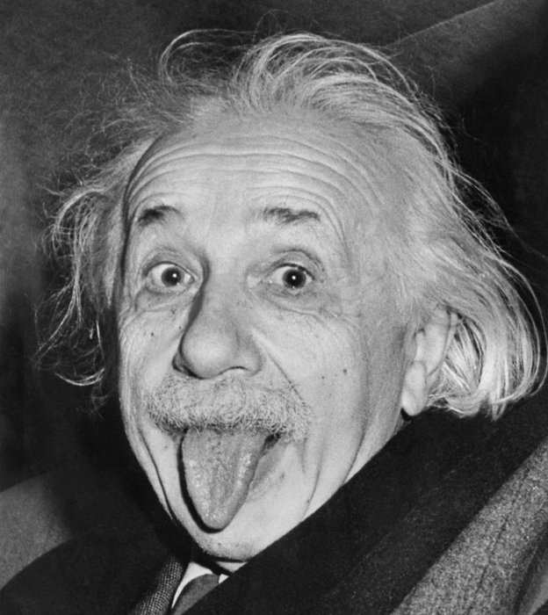
Our Hierarchical Subquery Evaluation
Ground Truth
Remaining Subqueries:
0
Label for the example with the best EE is requested
After 2 Queries
3.5
5.6
4.2
6
2.1
After 3 Queries
1.1
3.2
Notes:
We then repeat for the next set. For the next round the EE will be different for the active set
* Put in einstein

Slide 64
Our Hierarchical Subquery Evaluation
Ground Truth
Remaining Subqueries:
7
2
After 2 Queries
After 3 Queries
Notes:
Now we repeat for the next user query. For the next round the EE will be different for the active set

Slide 65
Results
Notes:
Now we show some results

Slide 66
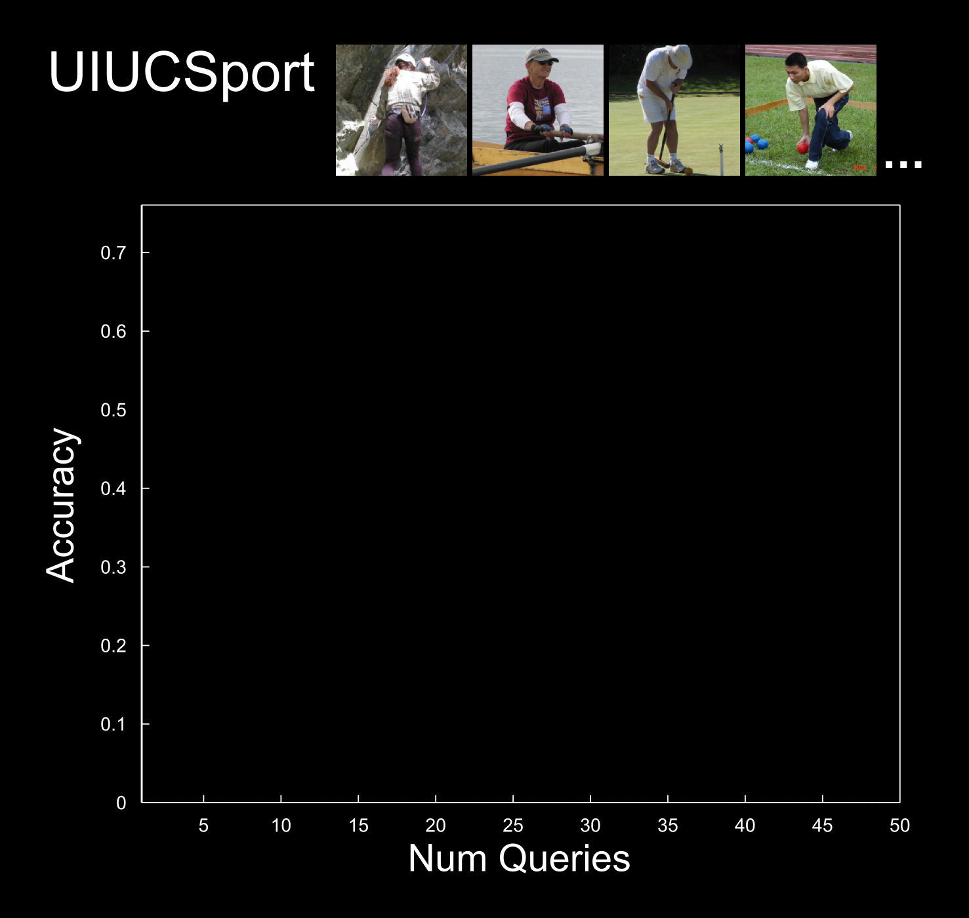
Results
1579 examples
8 classes
50 dim BoW PCA
Notes:
1579 examples
50 dim BoW PCA
8 classes
Start with 3 labeled nodes
172 mSec to return query to user

Slide 67
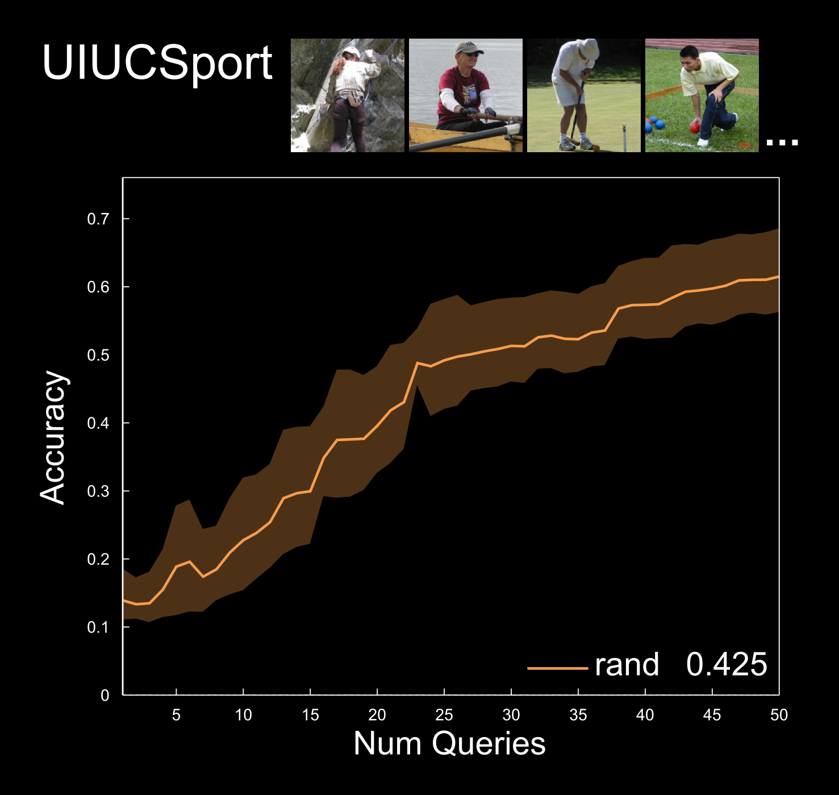
Results
Notes:
Error bars are the result of running several times

Slide 68
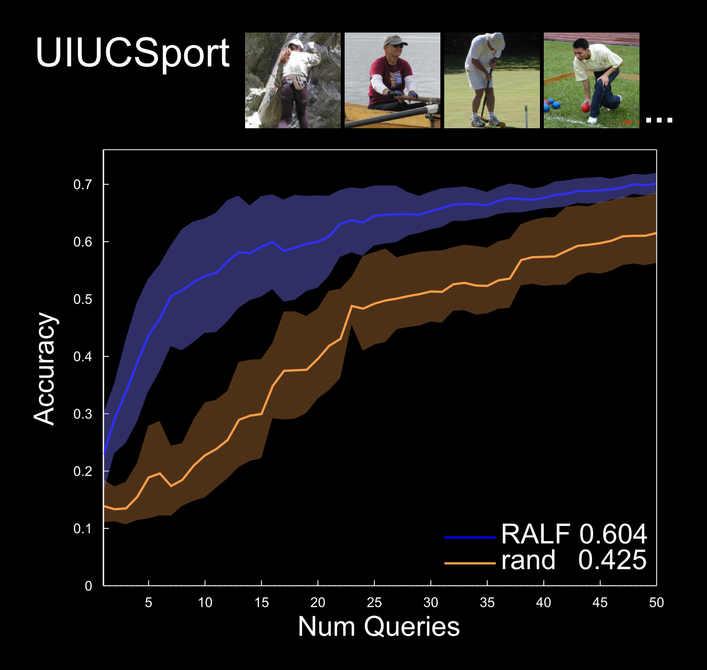
Results
Ralf: A reinforced active learning formulation for object class recognition
S. Ebert, M. Fritz, and B. Schiele
CVPR 2012

Slide 69
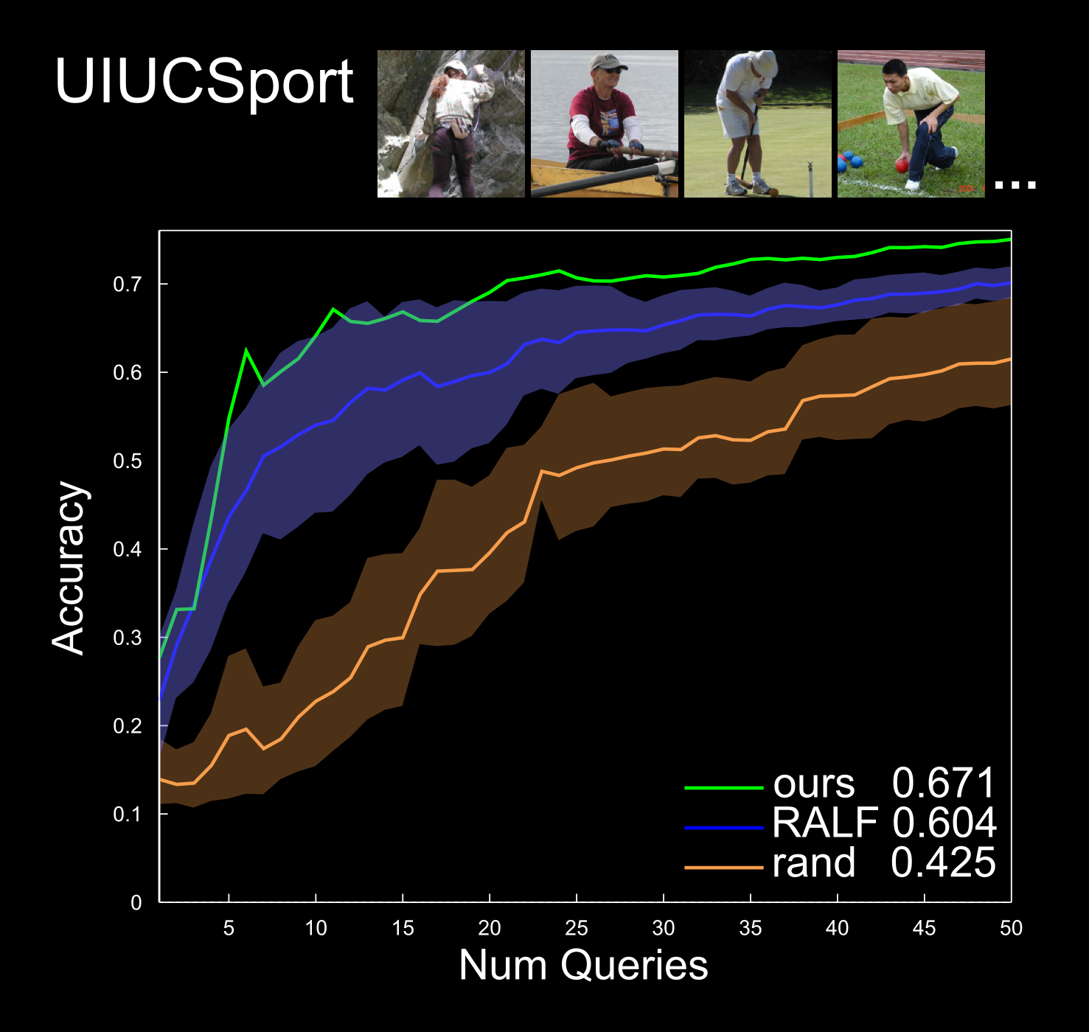
Results

Slide 70
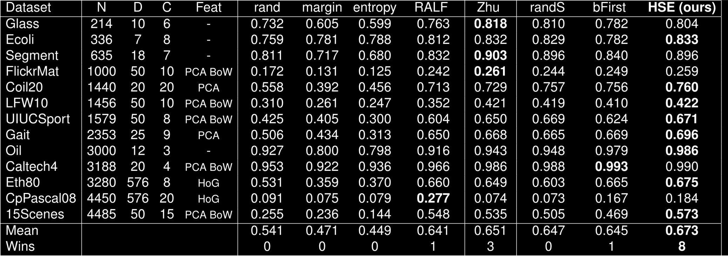
Results - Area Under Learning Curve
13 Different Computer Vision and Machine Learning Datasets
Notes:
Variety of feature encodings. Input is features, and number of classes, we use the same params for everything.
3 random queries. 10 nearest neighbour graph. Perplexty 30. 25Log(N)
Here we show the datasets on the rows axis and the learning strategies as columns

Slide 71
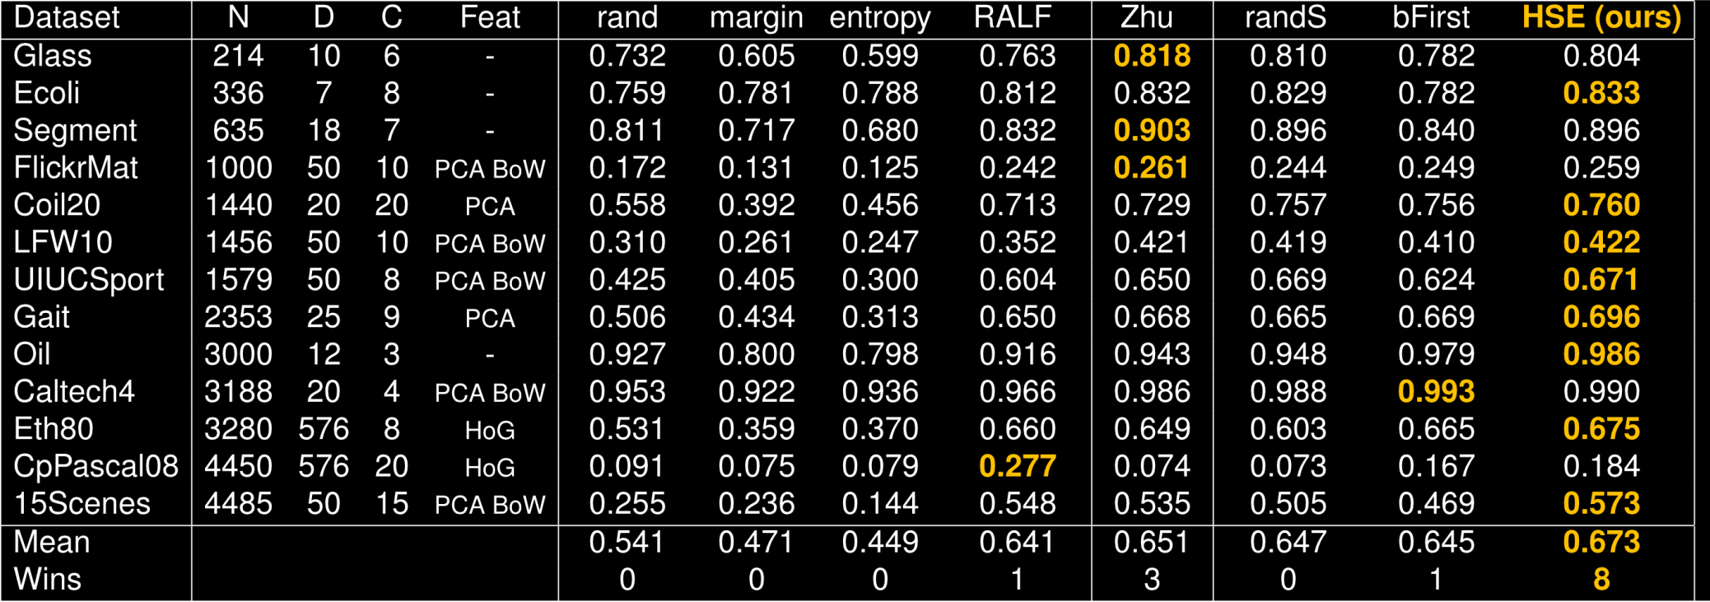
Results - Area Under Learning Curve
13 Different Computer Vision and Machine Learning Datasets
Notes:
Variety of feature encodings.
3 random queries. 10 nearest neighbour graph. Perplexty 30. 25Log(N)
For more results please see our paper

Slide 72
Summary
Hierarchical graph based semi-supervised active learning O(N²) -> O(NlogN)

Slide 73
Summary
Hierarchical graph based semi-supervised active learning O(N²) -> O(NlogN)
Robust to dataset type

Slide 74
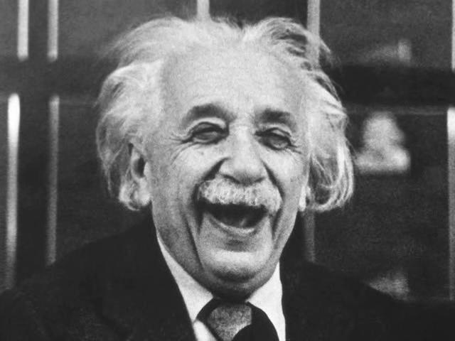
Summary
Hierarchical graph based semi-supervised active learning O(N²) -> O(NlogN)
Robust to dataset type
Best user query in the time available
Notes:
More or less subqueries can be evaluated depending on how long the oracle is willing to wait. Adaptive to time
Make our oracle happy

Slide 75
Future Work
Representation learning – update graph structure during labeling

Slide 76
Future Work
Representation learning – update graph structure during labeling
Model different annotation costs

Slide 77
Future Work
Representation learning – update graph structure during labeling
Model different annotation costs
Embed new datapoints into the graph
Notes:
Expert not always right might want to model that

Slide 78
Thanks!
http://visual.cs.ucl.ac.uk/pubs/graphActiveLearning
Come visit our poster 01-C-3
Notes:
Code will be available – try it on your dataset

Slide 79

Come visit our poster 01-C-3
http://visual.cs.ucl.ac.uk/pubs/graphActiveLearning

Slide 81
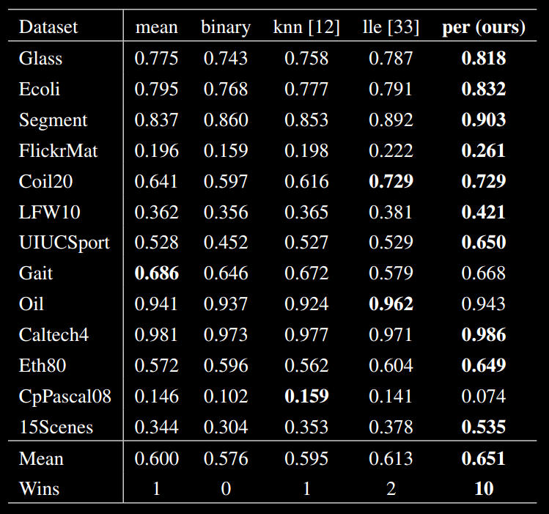
Graph Construction Comparison

Slide 82
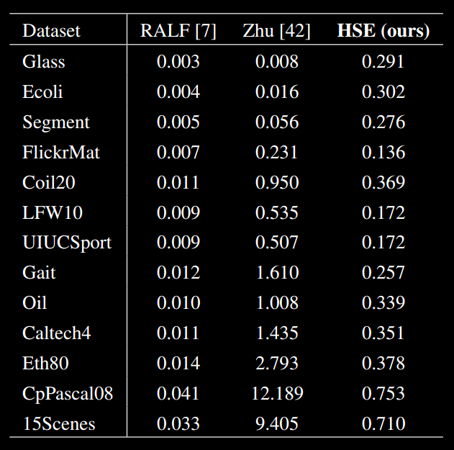
Timings

